Slide 1


SAP Full-Stack Developer training
ABAP on HANA, UI5 & Fiori, Analytics with OData
Anubhav Oberoy
Day – 8

Slide 2

Agenda – Day 8
Introduction to OData Services
OData basics
Client Side Query With Odata
Sap odata (v2)
Northwind OData services
Consuming Northwind OData Services from UI5 Application
--Break--
Deployment Options
EPM Data model
ABAP SEGW Class
Creating OData Service
Building GetEntitySet Method

Slide 3
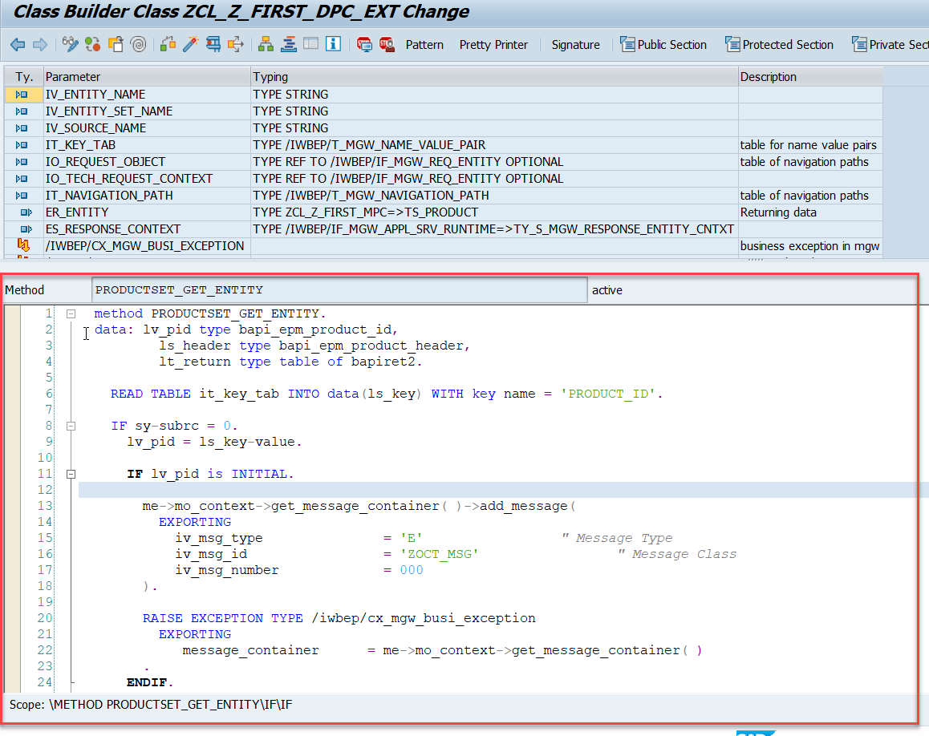
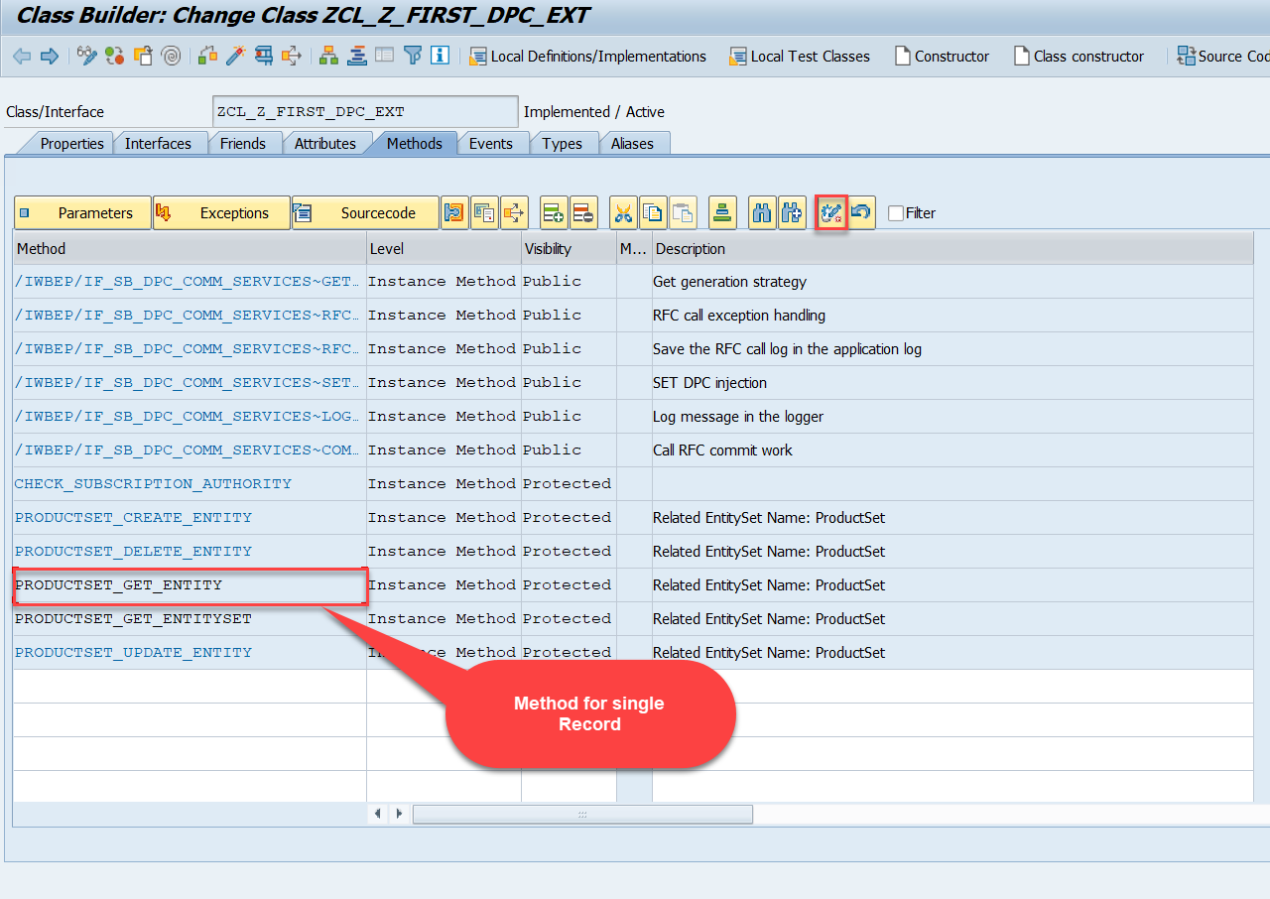
Building GetEntity(Single Record) Method
Go to DPC Extension of over service and redefine the method PRODUCTSET_GET_ENTITY

Slide 4
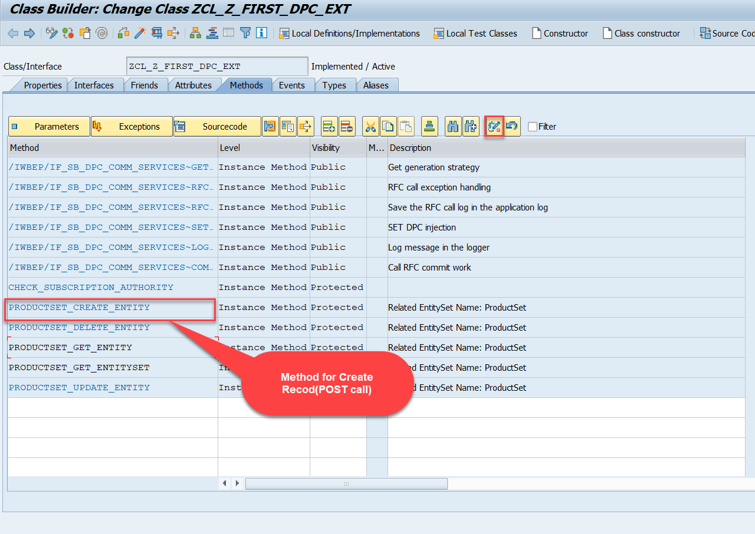
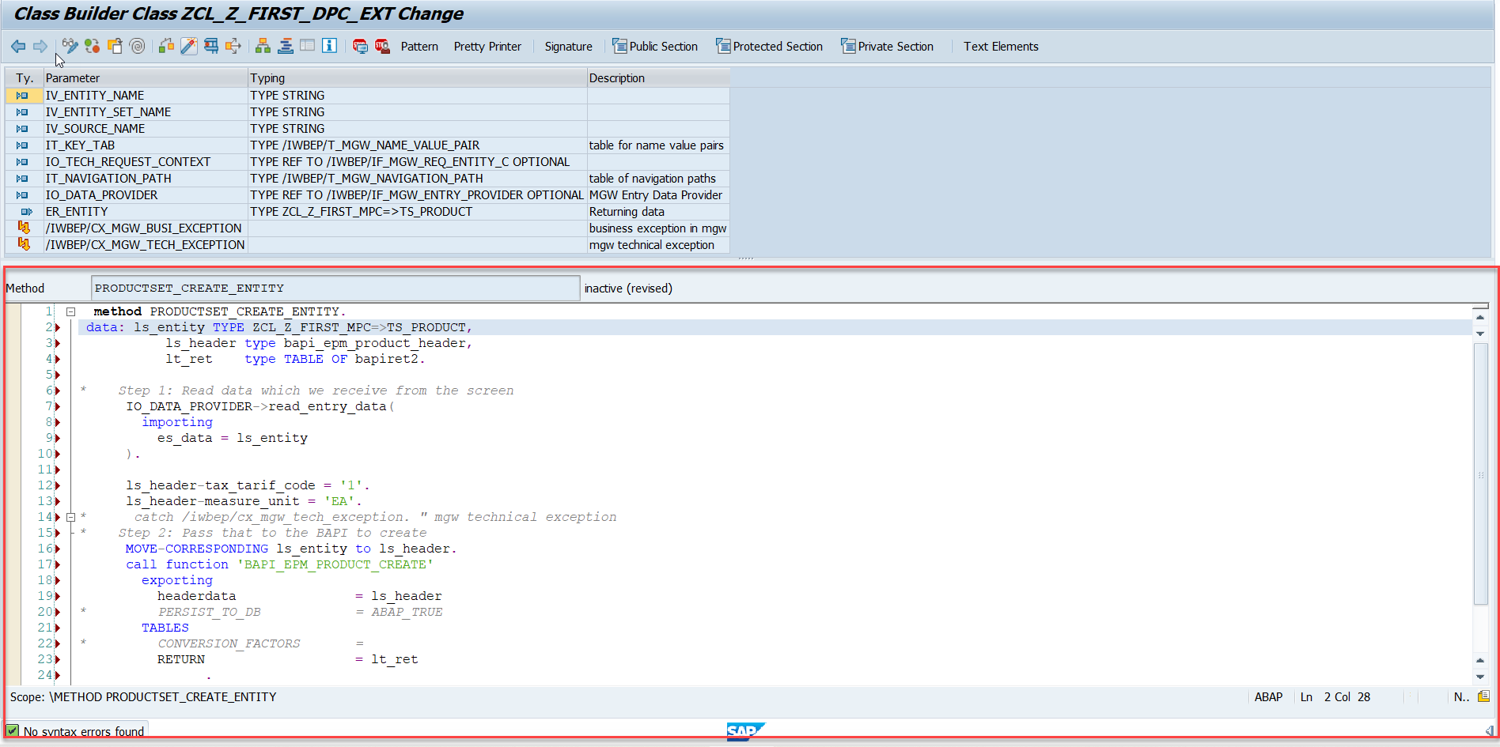
Building CreateEntity(POST) Method
Go to DPC Extension of over service and redefine the method PRODUCTSET_CREATE_ENTITY

Slide 5
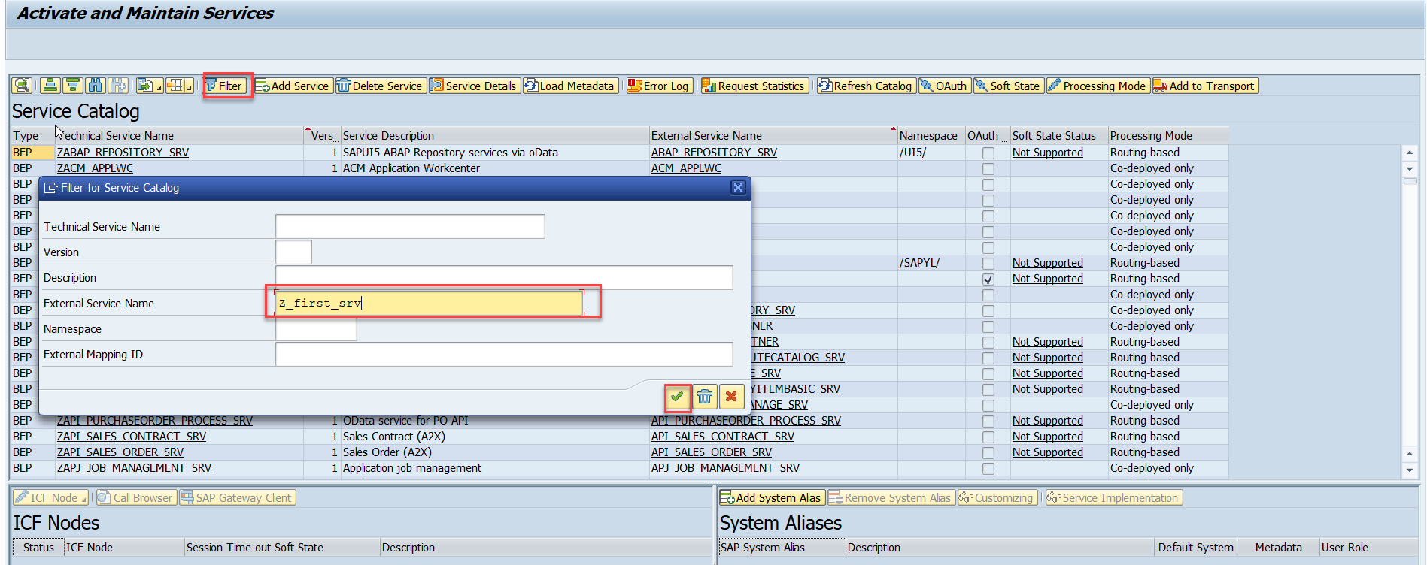
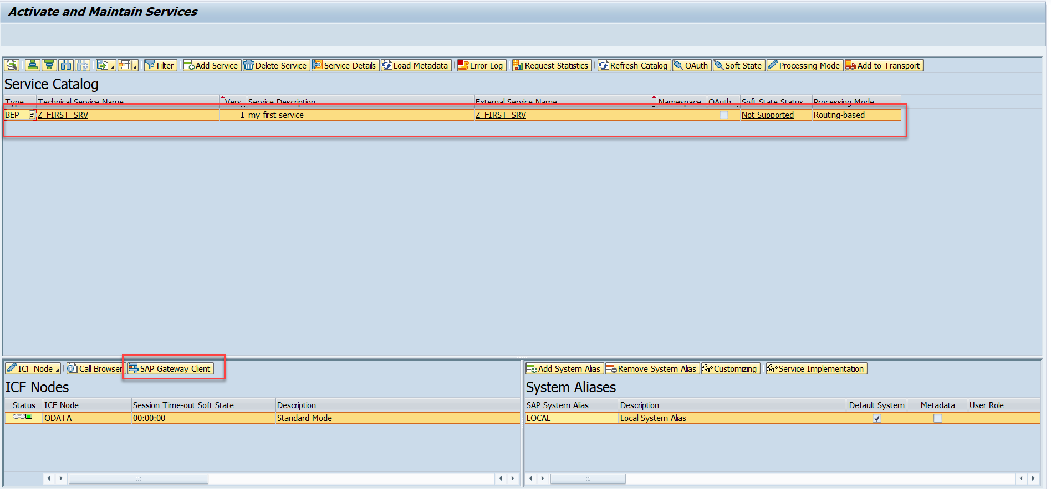
Testing the Create Method at Sap Gateway client
Step:1 Go to sap service maintance(tcode- /iwfnd/maint_service) and search for the service and then select the service and click on the sap gateway client

Slide 6
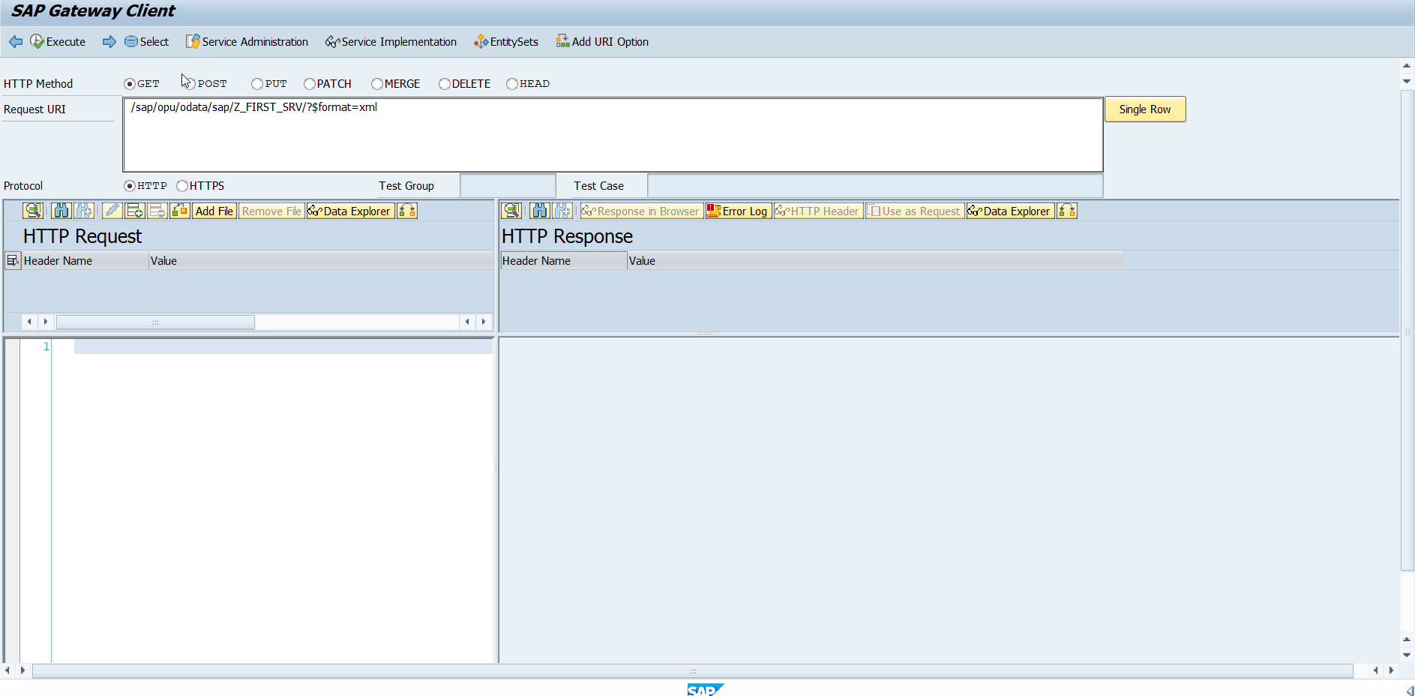
Testing the Create Method at Sap Gateway client
Step:2 Go to sap service maintance(tcode- /iwfnd/maint_service) and search for the service and then select the service and click on the sap gateway client

Slide 7
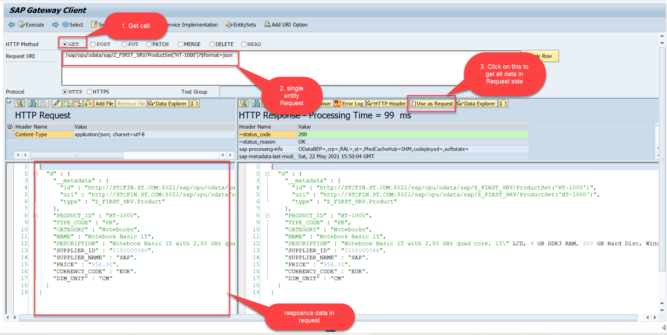
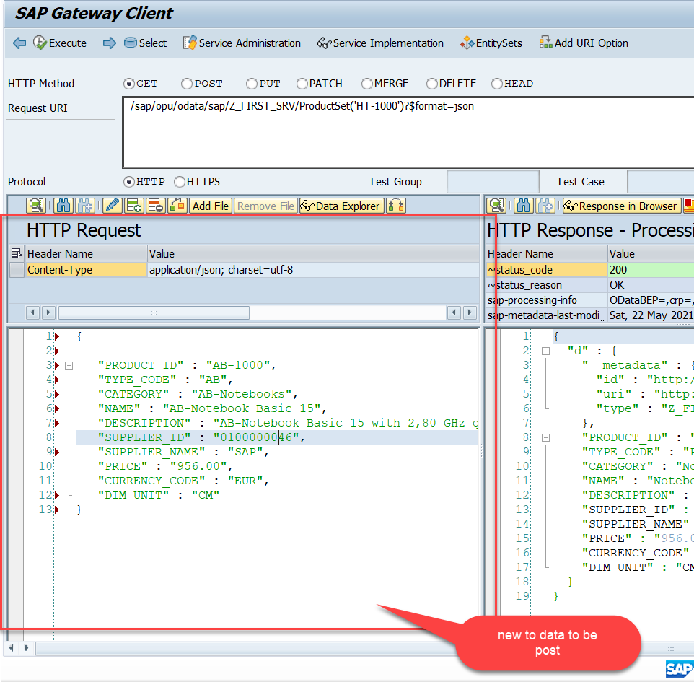
Testing the Create Method at Sap Gateway client
Step:3 Perform a getEntity in the Product set to get the payload to post (/sap/opu/odata/sap/Z_FIRST_SRV/ProductSet('HT-1000')?$format=json) and then clean the data and modify the payload as new.

Slide 8
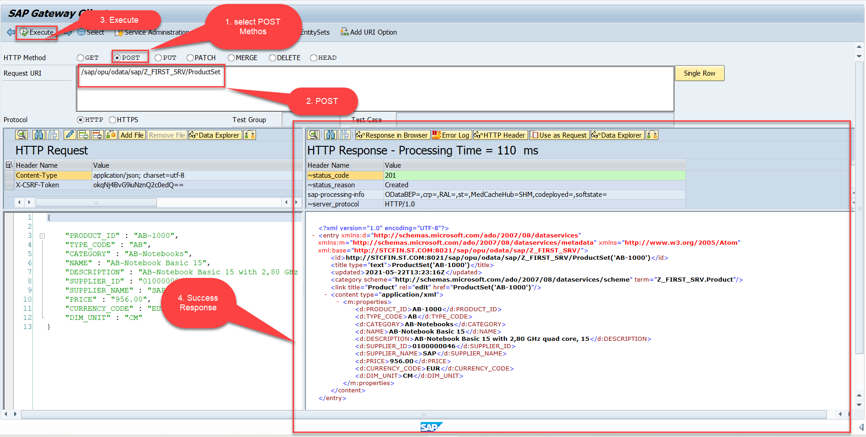
Testing the Create Method at Sap Gateway client
Step:4 send the post request at (/sap/opu/odata/sap/Z_FIRST_SRV/ProductSet)
You can check the saved data in database table (tcode – se11)

Slide 9
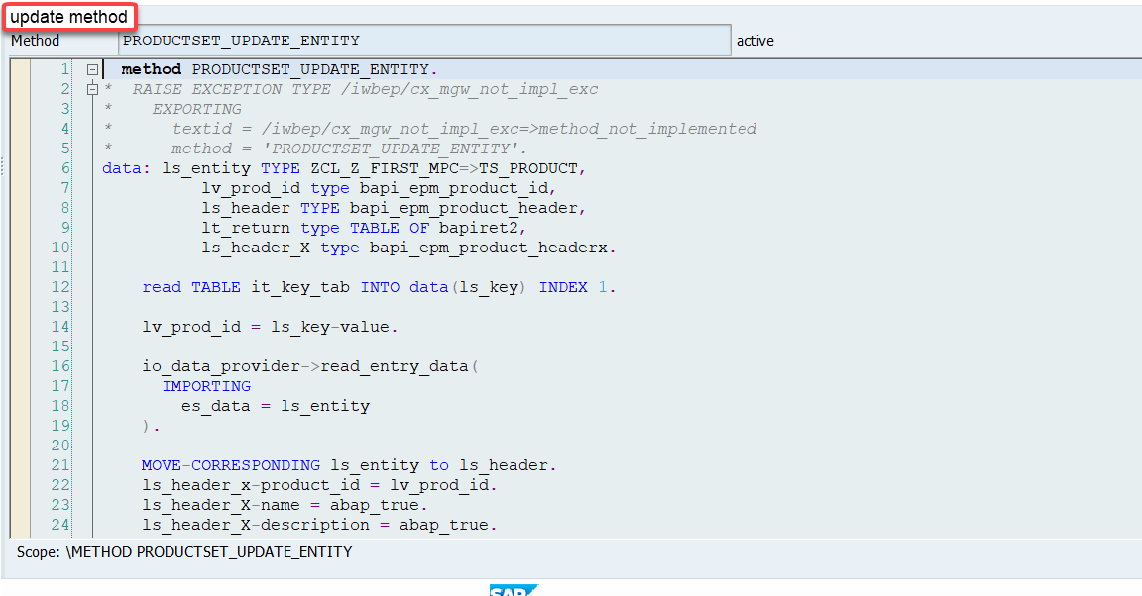
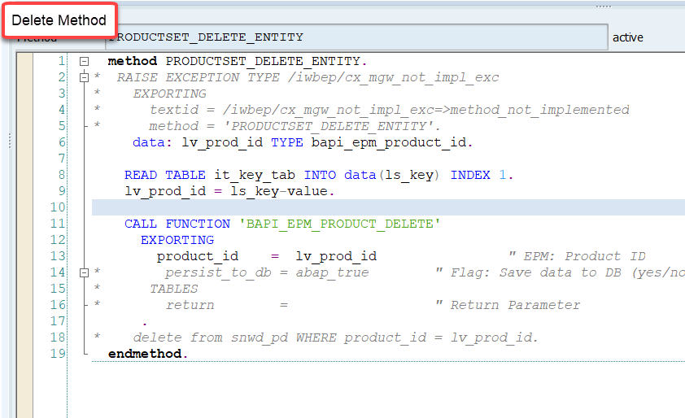
Implementing the delete and update method
We can implement the delete and update method in the cross-ponding dpc extension classes

Slide 10
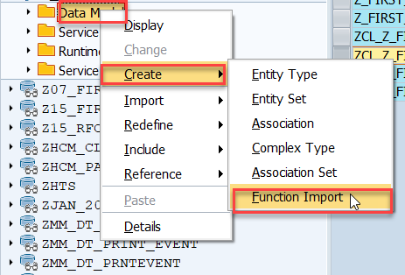
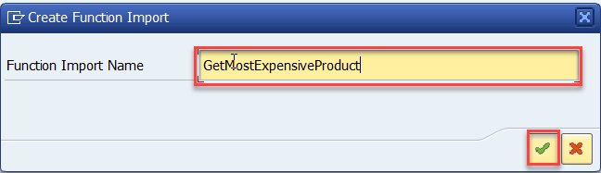
Function Import
At times, we need to implement the logic inside of OData which is not a direct CRUD operation e.g. calling a workflow, calling a BAPI which does some processing, Sending request to another server and can be invoked by the HTTP methods GET or POST .
For example: we can create the function import to GetMostExpensiveProduct in our Product set by the Category.
Step1: Right click the Data Model folder, and select Create and then select Function Import. Create Function Import dialog opens

Slide 11
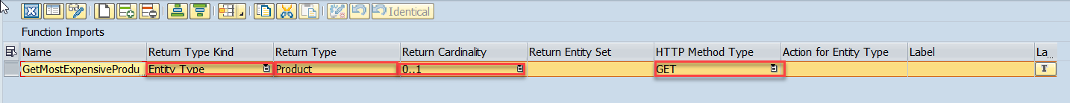
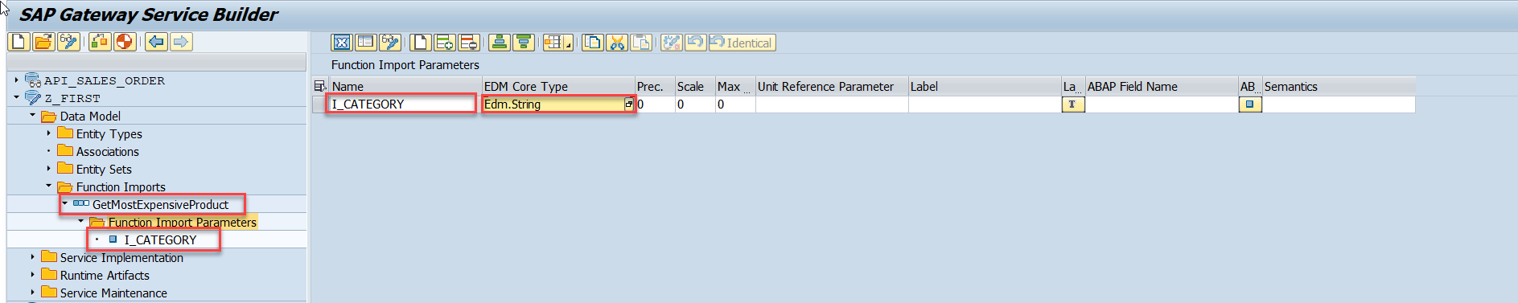
Function Import
Step2: Enter return type kind, return type, return cardinality & HTTP method Type
Step3: Giving function import parameters (I_CATEGORY)

Slide 12
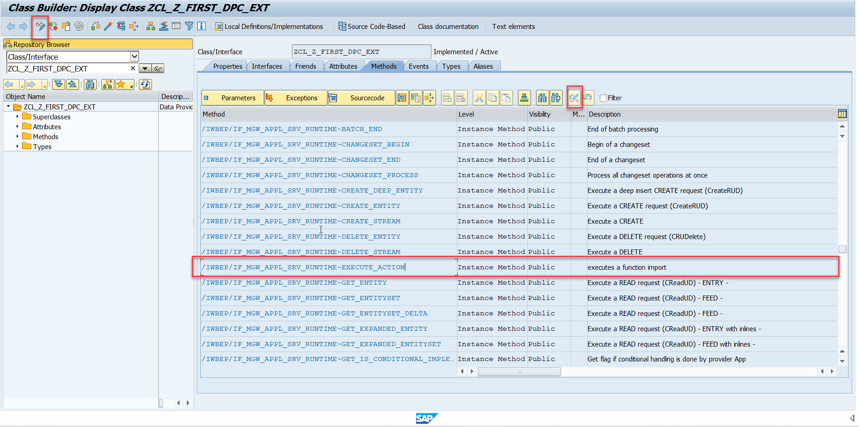
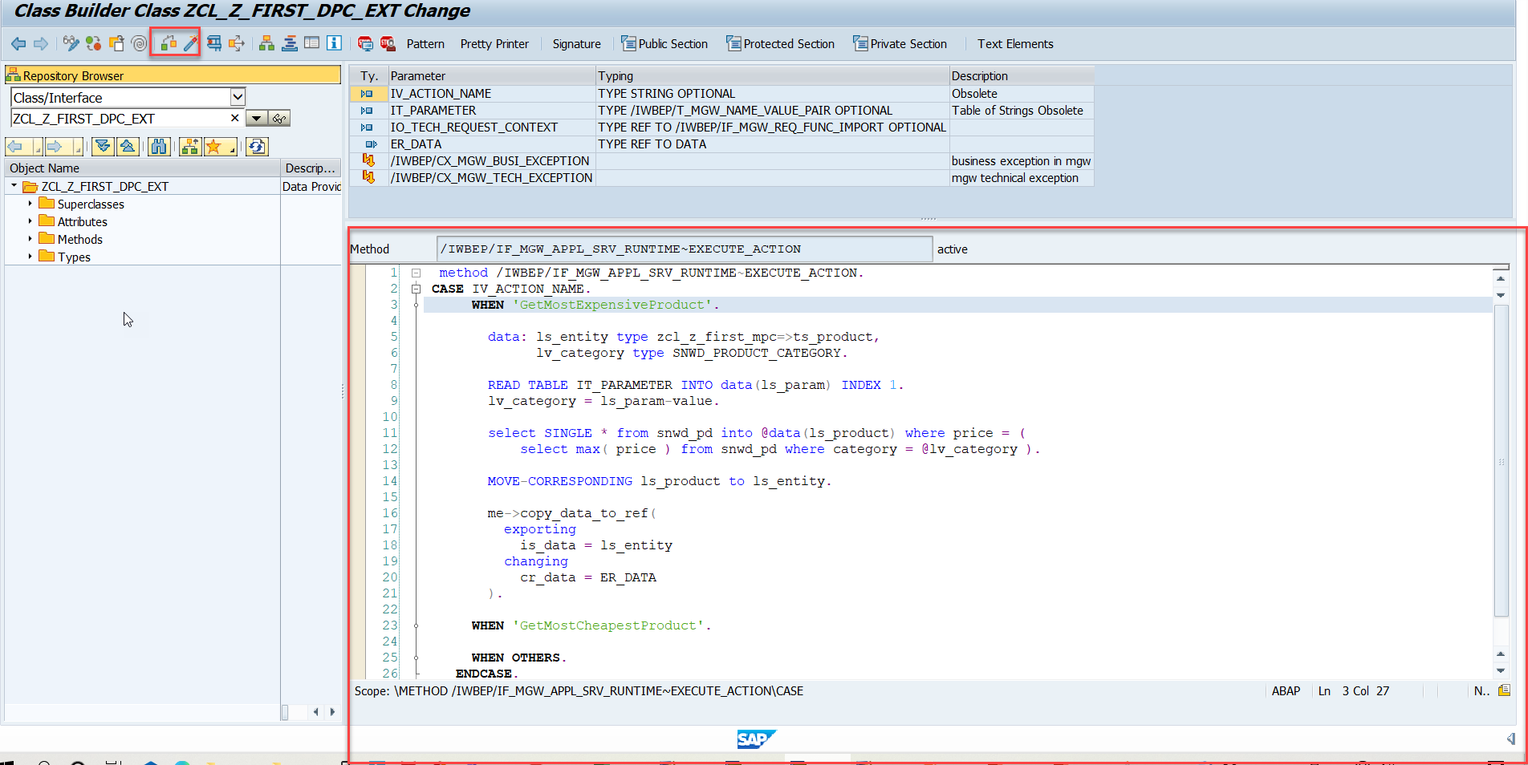
Function Import
Step4: Go to DPC Extension and search for the method--/IWBEP/IF_MGW_APPL_SRV_RUNTIME~EXECUTE_ACTION and redefine the class method

Slide 13
Title
Content

Slide 14
Title
Content

Slide 15
Title
Content

Slide 16

Break

Slide 17
Title
Content

Slide 18
Title
Content

Slide 19
Title
Content

Slide 20
Title
Content

Slide 21
Title
Content

Slide 22
Title
Content

Slide 23
Title
Content

Slide 24
Title
Content

Slide 25

End of Day 8

Slide 26

Questions

Slide 27

Anubhav Oberoy

Slide 28


We’re committed to empower you to be
Most Desirable Resource
through powerful training solutions.
We build the workforce of the future.
250+
Corporate Clients
30,000+
Learners Trained
25000+
Learners Placed
FREE WEBINARS
Sign up for free webinars with industry experts every fortnight!
Enroll Now!
Contact us today!
https://anubhavtrainings.com/

Slide 29




More from AnubhavTrainings.com

Slide 30
Title
Content

